Slide 1
HMT 801 Travel Agency and Tour Operations
UNIT 3
Itinerary Planning and Tour Package
Topic
Meaning
Concept
Definition and
Classification of Tour Packages.

Slide 2
Package tour
Package tourism is traditionally associated with the production of mass, standardized holidays, for example, beach holidays to Europe.
In 1841 Thomas Cook organized the first package holiday as we know it today. It may have only been a short trip between Leicester and Loughborough

Slide 3
Benefits of tour package
Incidentally, World War II has tremendously developed the package tour concept because of the following reasons:
• Social and Economic Conditions • Lower Cost • Increase in Aircrafts • Marketing Conditions • Legal Requirements • Integration took place.

Slide 4
Package tour definition
a pre-arrangement, prepaid trip that combines two or more travel components like airfare, airport transfer, accommodation, and other services.
Holloway defines a tour package as “a total tourism product consisting of transportation from the market area to the destination, accommodation at the destination and recreational activities promoted by the tourists.”
According to Gregorg “a tour package is advertised journey including specific features, arranged and promoted with tour literature by a tour operator and paid for in full by the tourists before starting the tour.”

Slide 5
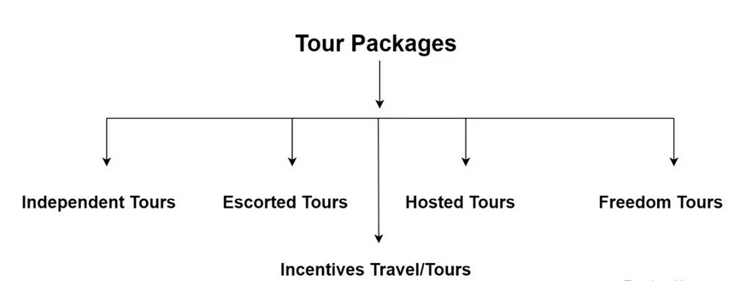

Slide 6
Independent Tour
Independent tours are prepared/formulated for those tourists who want to travel independently. The components of such tours are air travel, air transfer, accommodation, travel documents, sightseeing, boat riding, entertainment, and other travel services.

Slide 7
Escorted Tour
When a travel agency includes the services of a well-educated and trained tour manager in its package, the tour is called an escorted tour. Basically, escorted tours are meant for those travellers who are planning to visit a foreign country first time.
The escort’s responsibilities and duties are to provide comprehensive information and assistance to the group or individual traveller, at the origin, en route and at the destination place. The excursion tours are an example of escorted tours.

Slide 8
Hosted Tours
A hosted tour means when an agency utilizes the services of another agency at a particular destination. Suppose a group of French tourists is coming to India. When the group arrives in India, they are greeted at the airports by TCI, which assists them in clearing their baggage and transfer them to the hotel.

Slide 9
Incentives Travel/Tour
It is a motivational programme or a fully paid holiday which is given to the employees by the enterprises as a reward. Mostly in medium and large-scale companies and usually too distant destinations to spur them in maintaining their track record, increase output, improve the image and moreover to earn the long period loyalty of the employees.
There are a number of other packages offered by a tour company such as a custom tour an excursion tour, an adventure, and special interest package tours.

Slide 10
Freedom Tours
Freedom tours are becoming very popular these days among the working class. These tours are designed as per the choice of tourists. Tourist is free to choose and plan how they want to travel and enjoy their holidays. These types of tours are meant for the kind of people who like to decide how, when, and where to travel.
This tourist may an individual, family, or group holidays for families and group travel for business. These tours are promoted and developed by the ORBIT

